Slide 1
Order Book

Slide 2
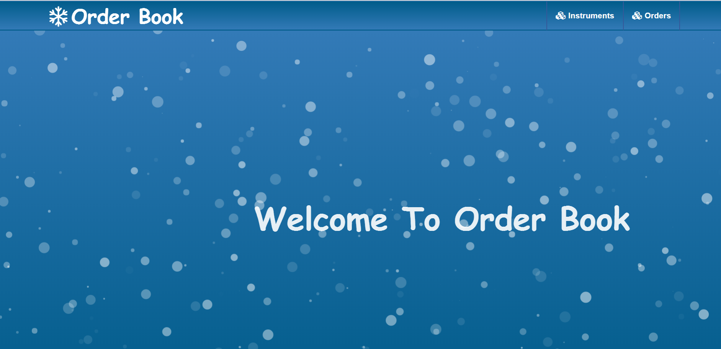
Home Page

Slide 3
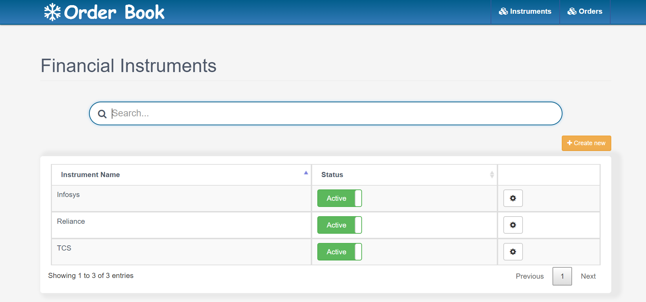
List of Instrument

Slide 4
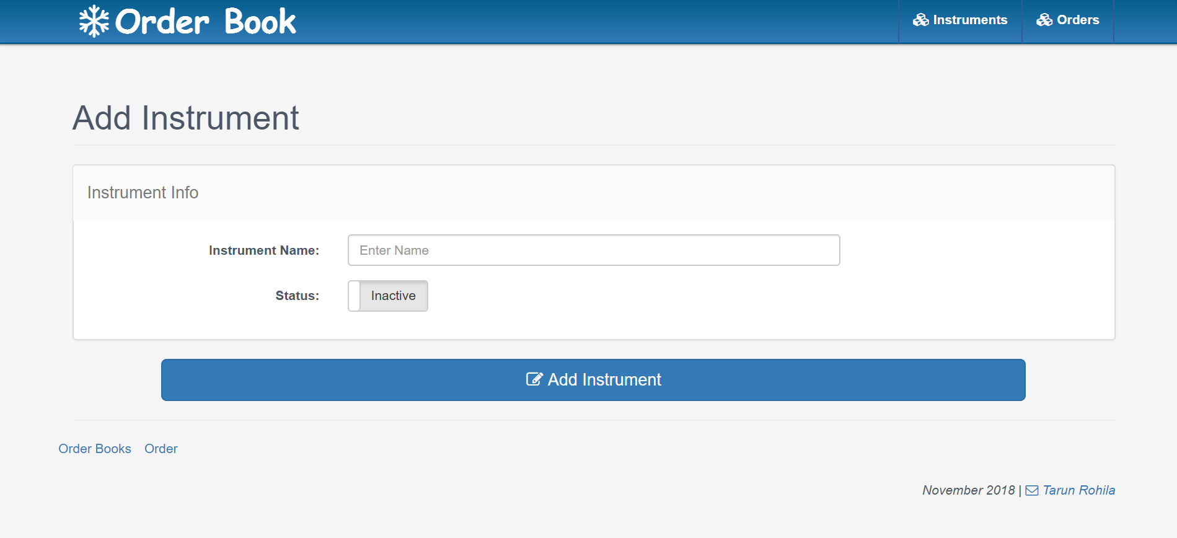
Add New Instrument

Slide 5
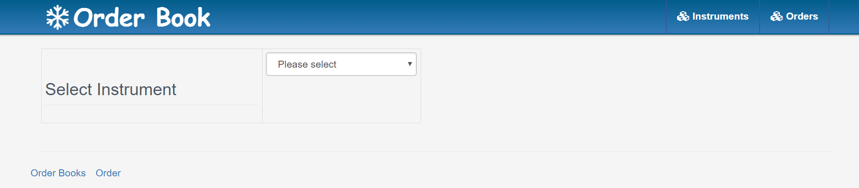
Open Instrument to Order

Slide 6
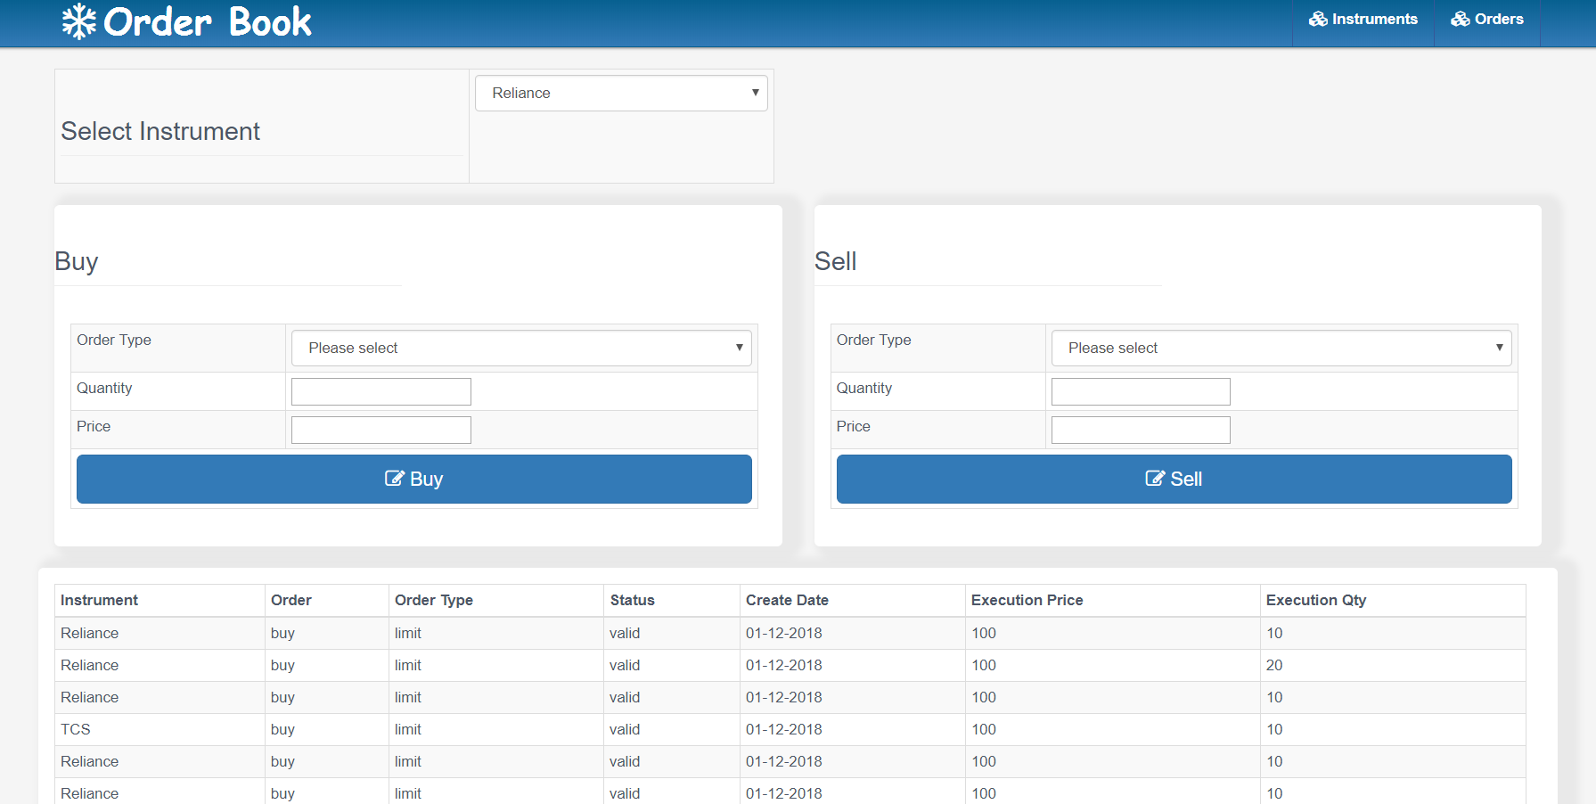
Buy/Sell Order

